Slide 2


Slide 3
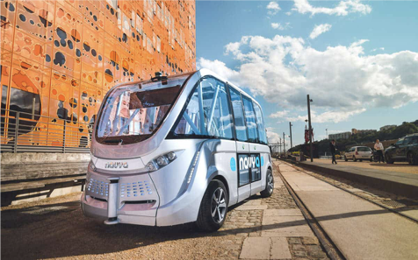
TRANSPORT

Slide 4
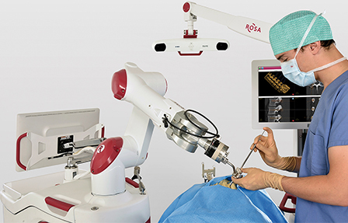
HEALTHCARE

Slide 5
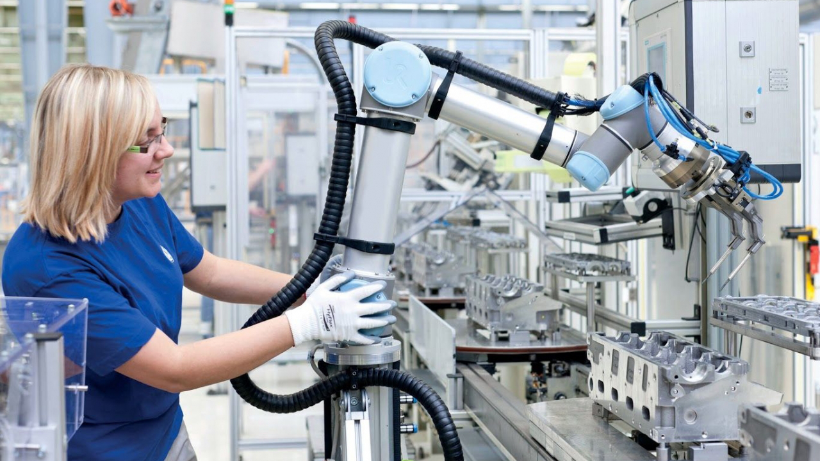
INDUSTRY

Slide 6
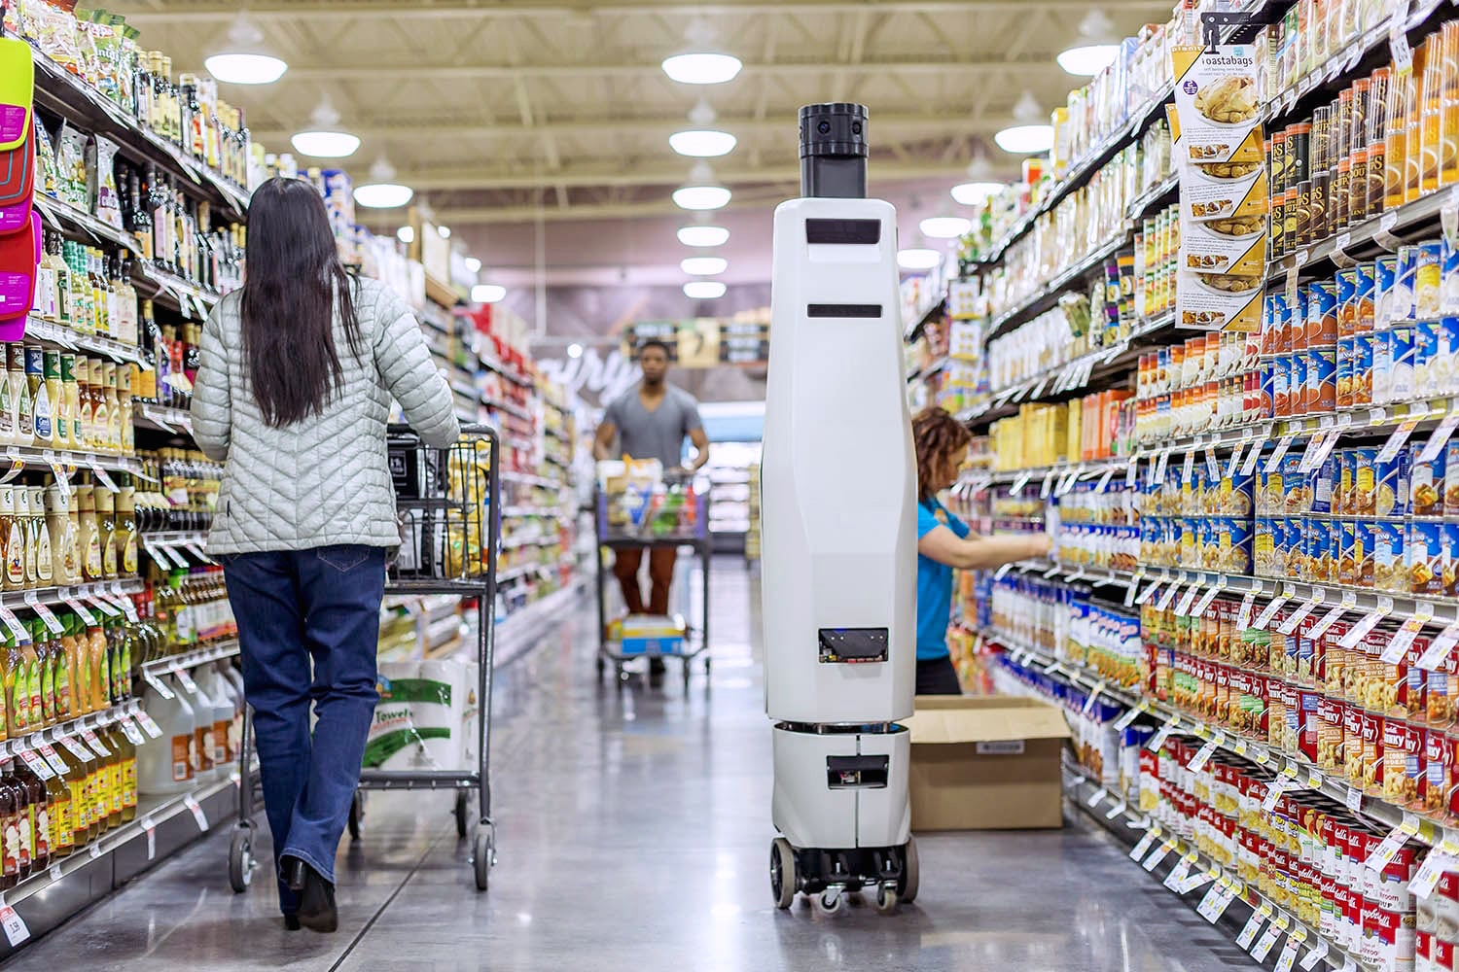
RETAIL

Slide 7


