Slide 1
Standards for Ethical Conduct in UK Engineering
Prof Chris Atkin CEng FRAeS
Chairman, Engineering Council

Slide 2


Ethical Principles – Pocket Version

Slide 3
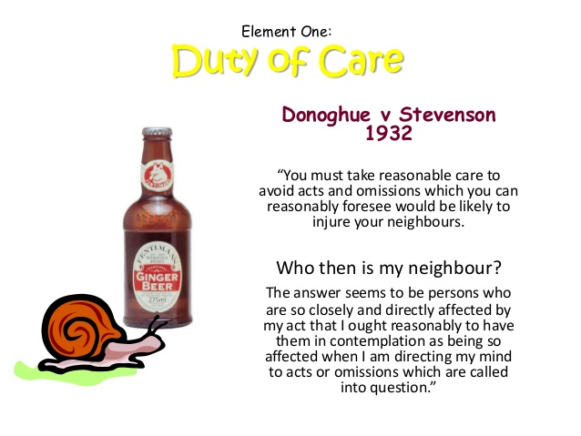
www.slideshare.net

Slide 4
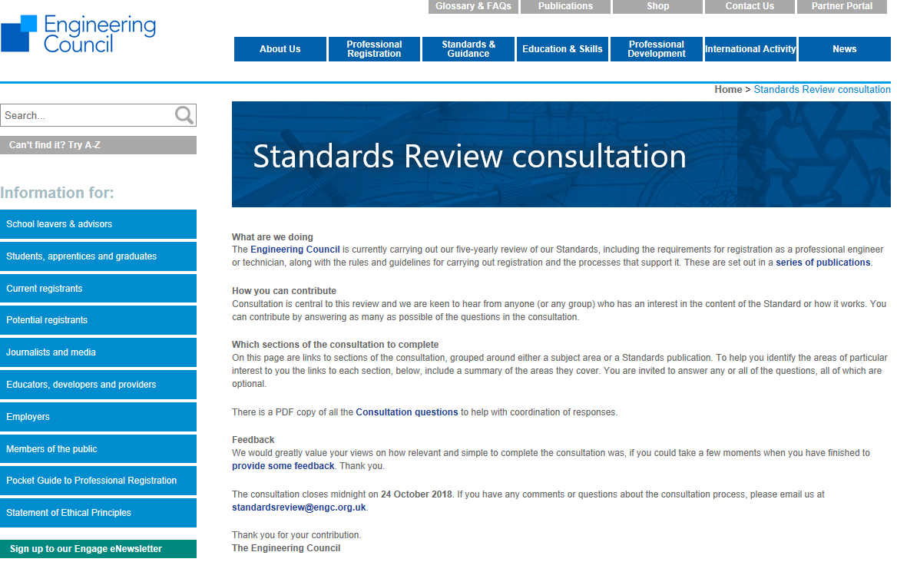
2018 Consultation on Standards
https://www.engc.org.uk/standards-review-consultation/

Slide 5


geekynerfherder.blogspot.com
fanart.tv

Slide 6


World-changer
Wealth-creator

Slide 7
Ethics in Engineering: Personal Reflections
Does ethical awareness require a breadth of vision that comes with experience and seniority?
  It’s very easy, as a younger professional, to assume that ethics is someone else’s problem
  Keen employees align themselves with corporate goals and immerse themselves in the delivery of their projects
Can we accelerate that breadth of vision in some way?
Raising ethical concerns about established practice is more difficult
  The most common conflict is surely between ethical and commercial drivers
As with most personal development, the easiest way to gain ethical awareness is to get involved – either by personal experience or by interaction with those working in the area.

Slide 8
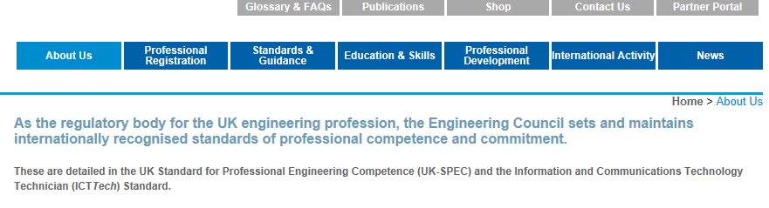
The Engineering Council as a setter of Standards
Categories
Learning objectives for the formation of engineers and technicians
Thresholds of professional competence and commitment at which an individual may be recorded on the Register
Codes of professional conduct
Requirements for continuing professional development
Coverage of ethical conduct
✓
✓
✓
(✓) – work in progress

Slide 9
Engineering Council as Regulator
EngC
Formation
PEI 1
PEI 6
Competence
PEI 2
Review Team
PEI 7
CPD
PEI 3
PEI 8
PEI 4
PEI 9
PEI 5
“Cross-regulation”

Slide 10
Engineering Council as Regulator
Regulation of ethical conduct is a complex matter
  Boundaries can be ambiguous and subjective
  Guidance is essential
Regulation should start with peer-to-peer intervention
  a light-touch version of whistleblowing
  allowing you to ‘call out’ colleagues
backed by a shared commitment through your membership of a professional institution
But there can be no regulation without registration
  Ethical conduct in engineering starts with registration
    A commitment to peer review and CPD
    Scope to include senior leadership roles
We need the support of employers to reinforce this message

Slide 11

Formation of Engineers: Pitching Ethics Appropriately
https://www.theatlantic.com/magazine/archive/2015/09/the-coddling-of-the-american-mind/399356/

Slide 12
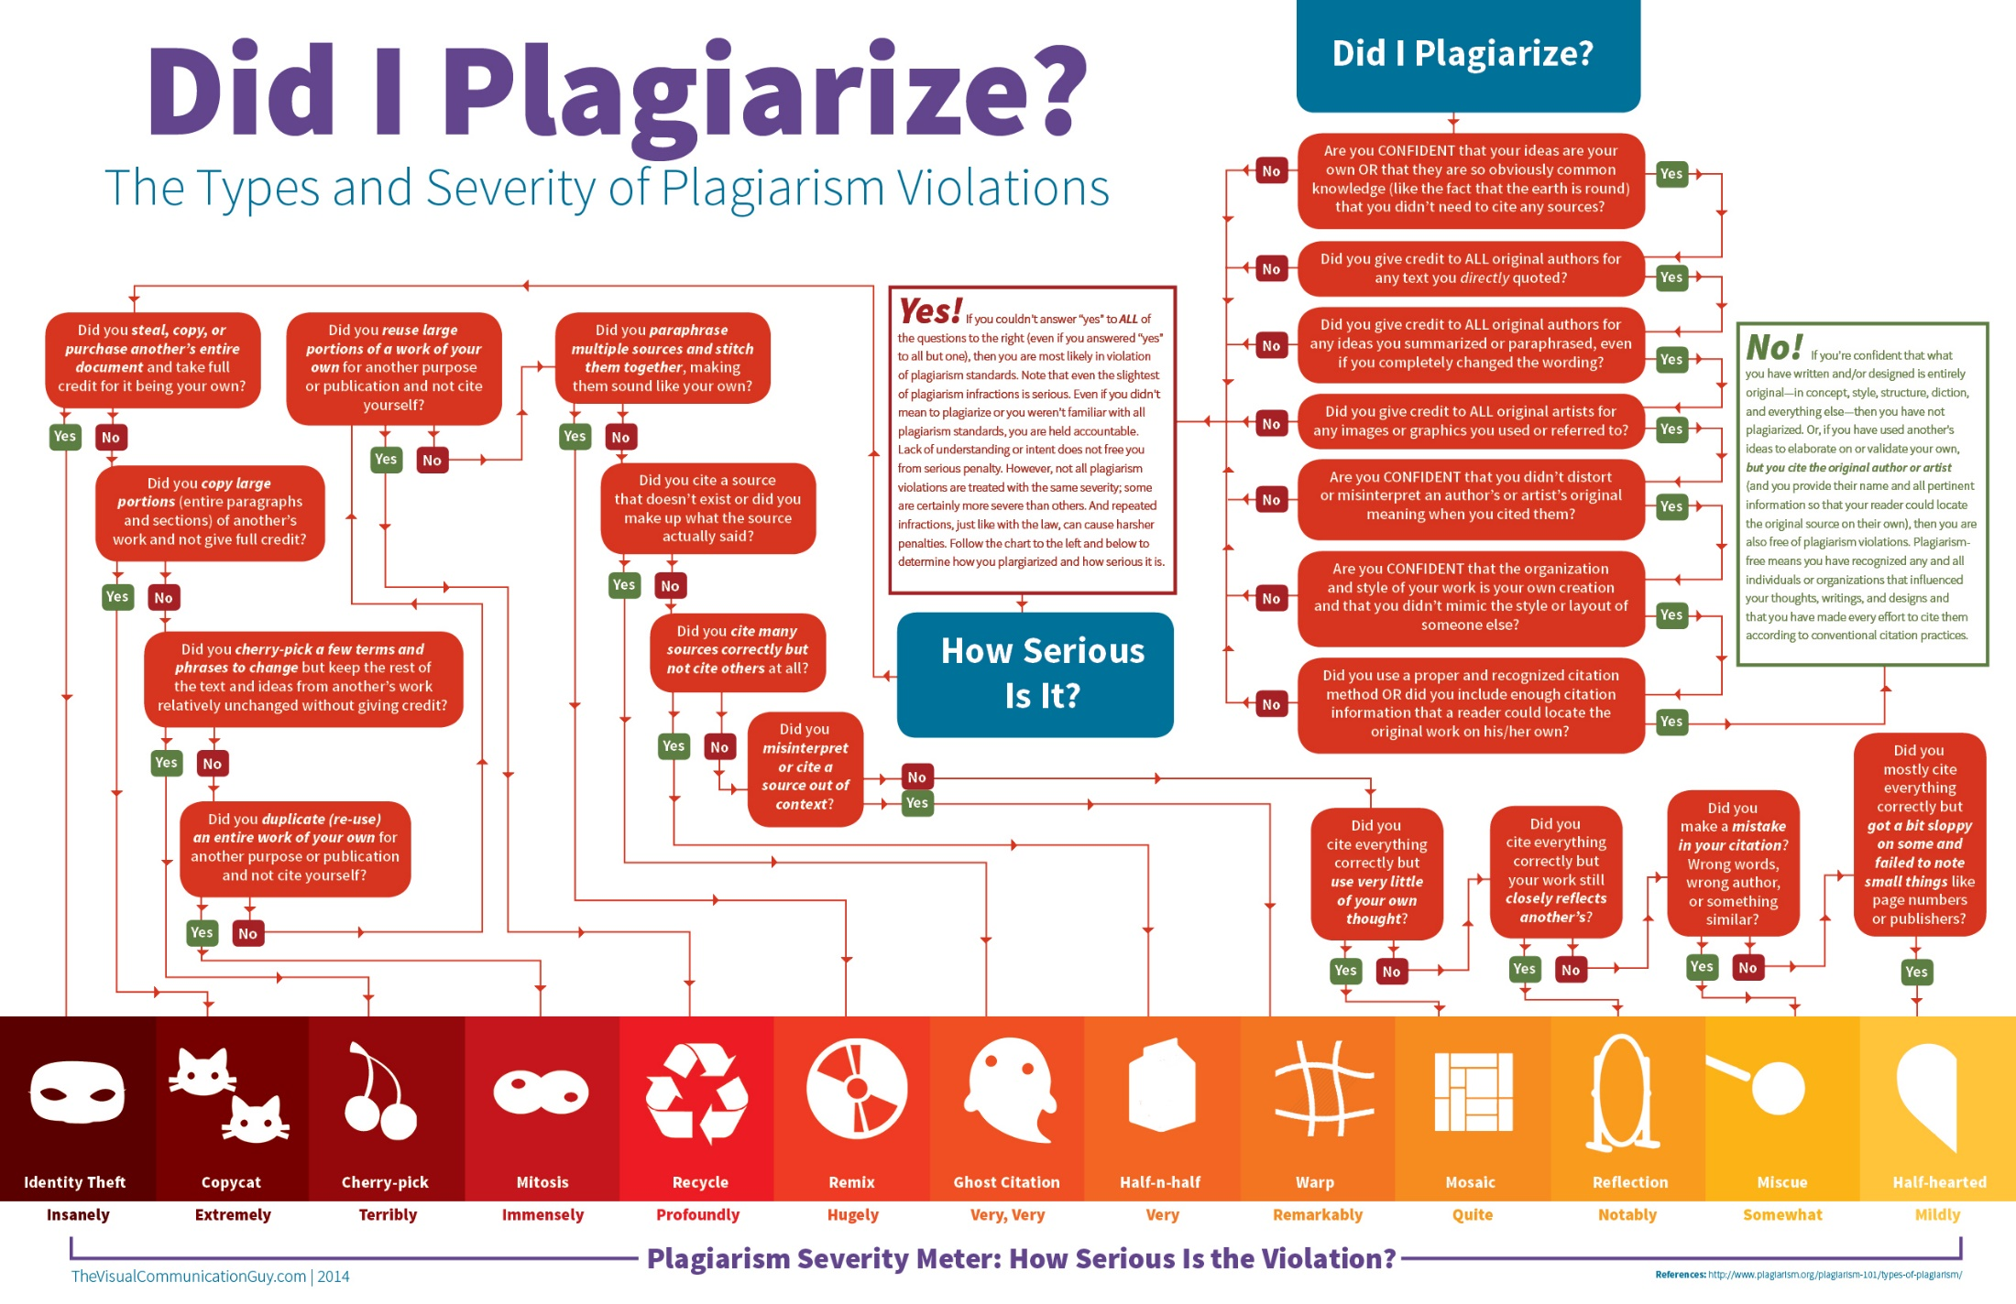


Slide 13

Formation of Engineers: Pitching Ethics Appropriately
Instructors need to tackle more basic and personal ethical questions before examining more complex case studies
Further and higher education should be ideal environments for young engineers to learn how to learn from their peers
  This is a pre-requisite for a culture of ethical conduct
Scope for confusion as a result of the present culture of results!

Slide 14
Embedding Ethical Principles: Concluding Remarks
Principles must lead to a culture of ethical practice
  Peer-to-peer activity is key to this
  Likewise support from the institutions
Ethical behaviour means different things to different people and at different levels of career ‘maturity’
  This must inform our guidance and interventions
    Regulation of ethical conduct is far more nuanced than enforcement of standards or legislation
Ethical practice has, for a long time, featured in the EngC’s mission to deliver public confidence in the profession
We need to increase the proportion of registrants for our guidance and regulation to have greater impact
  Employers have a key role to play

